Slide 1
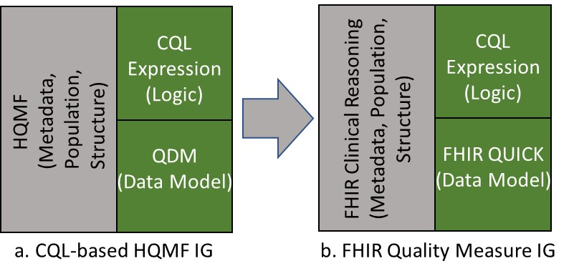
FHIR Clinical Reasoning
(Metadata, Population, Structure)
CQL Expression
(Logic)
CQL Expression
(Logic)
HQMF
(Metadata, Population, Structure)
QDM
(Data Model)
FHIR QUICK
(Data Model)
a. CQL-based HQMF IG
b. FHIR Quality Measure IG

Slide 2
Quality Measurement Standards Landscape
Measure Specification
Measure Reporting
Producers
Consumers
Providers
Patients
Care Givers
Clinical Systems
Aggregators
Payers
HIEs
Health Agencies
FHIR
Interactions
Measures
MeasureReports
CQL
Specifiers
Quality Agencies
Government Agencies
Industry Consortiums
Clinical Societies
Quality Measure IG
QI Core
DEQM IG

Slide 3
Data Model Standards Landscape
Quality Measurement focused
DEQM
Quality Improvement focused
QI Core
Constraint-based Definition
Consensus-based Promotion
US Realm specific profiles
US Core
Universally applicable resources and guidance
FHIR

Slide 4
Quality Reporting Scenarios
Exchange Scenarios
Reporting Scenarios
Providers
Aggregators
Receivers
Measurement Period
1
Submit Data
4
Individual
2
Collect Data
5
Summary
3
Subscription
6
Patient List

